Slide 1
Lesson 1:
Front-end web development

Slide 2
Introduction
Traditionally, when web developers started building websites in the 90s, they would wear all the hats.
  they would set up the server,
  write all the server-side code that would eventually output HTML and
  finally sprinkle on some CSS to make things look pretty.

Slide 3
Introduction
Due to the advancement of modern web technologies and computer hardware, we’re able to create more sophisticated experiences than ever.
Because of this complexity, the role of a web developer has naturally evolved and split into separate disciplines.
Specifically, a line was drawn between the back-end and front-end.
    Back-end being server-side programming and front-end being client-side.

Slide 4
Introduction
A front-end dev’t deals with technologies used to design and develop the user interface of the web application and its interaction with the users.
It is the practice of producing HTML, CSS and JavaScript for a website or Web Application so that a user can see and interact with them directly.
Also known as “client-side development”

Slide 5
Introduction
Objective of designing a site is to ensure that when the users open up the site they see the information in a format that is easy to read and relevant.
This is further complicated by the fact that users now use a large variety of devices with varying screen sizes and resolutions
    thus forcing the designer to take into consideration these aspects when designing the site.

Slide 6
Introduction
They need to ensure that their site comes up correctly in different browsers (cross-browser), different operating systems (cross-platform) and different devices (cross-device)

Slide 7
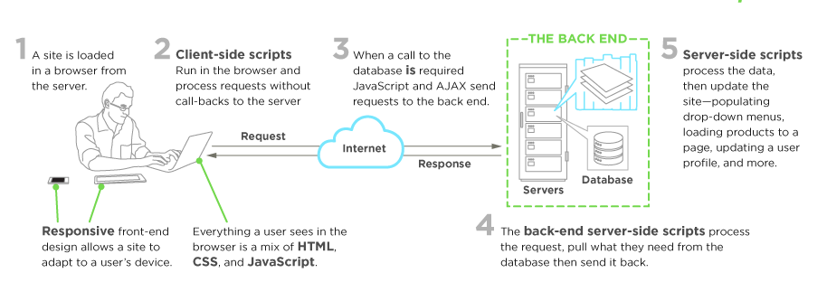
Introduction
Front end web development

Slide 8
Front–end languages
HTML — Hypertext Markup Language
  Website pages and documents are written in HTML, which consists of base content combined with inter-linear tags that provide semantic information about the content they enclose.
CSS — Cascading Style Sheet
  Provides a set of detailed instructions to the browser (or a printer) about how the content of an HTML document should be displayed. It includes details like font declarations, sizing, color, on-page placements, and layering precedence.

Slide 9
Front–end languages
JS — JavaScript
  A scripting language that can be used to provide rich web interaction inside a browser. It is event-driven, responding to actions taken by the user (such as clicking, moussing, hovering, and typing).

Slide 10
Client-server architecture
A network architecture in which each computer or process on the network is either a client or a server.

Slide 11
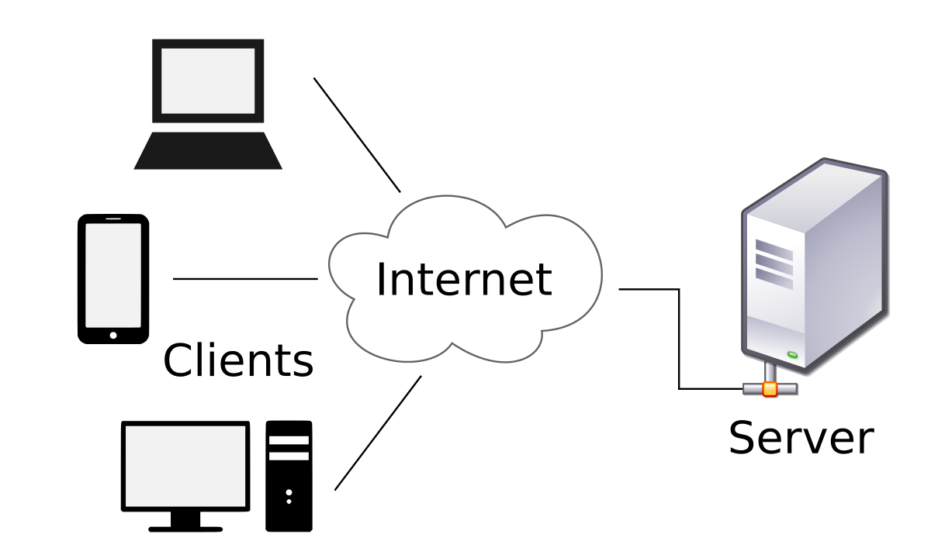
Client-server architecture
Components
  Clients
  Servers
  Communication networks and protocols

Slide 12
Client-server architecture
Clients
Applications that run on user’s computer
Rely on servers for
  Files, devices and processing power
Example: E-mail client, Web client (browser)
  An application that enables you to send and receive e-mail
Clients are Applications

Slide 13
Client-server architecture
Servers
Computers or processes that manage network resources
  Disk drives (file servers), Printers (print servers), Network traffic (network servers), Web Servers
Example: Database Server
  A computer system that processes database queries
Servers Manage Resources

Slide 14
Client-server architecture
Communication Networks
    Connect clients and servers

Slide 15
Client-server computing
Process takes place on the server and on the client
Servers
  Store and protect data
  Process requests from clients
Clients
  Make requests
  Format data on the desktop

Slide 16
Client-server computing
Application Components
Software application functions are separated into three distinct parts
  Presentation, application logic and data management

Slide 17
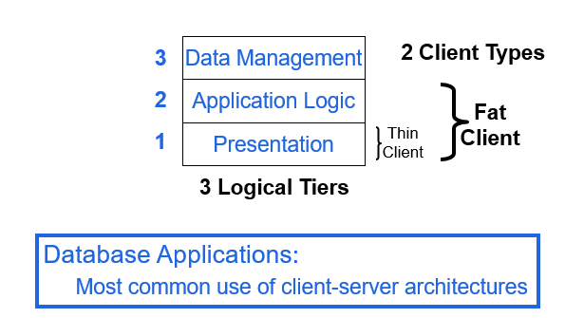
Client-server computing

Slide 18
Revision of client side scripts
HTML
  Structure, elements and forms
CSS
  How to, using CSS as internal, external and inline
JavaScript
  Structure, using js with HTML (internal and external js)

Slide 19
Revision of client side scripts
Exercises

Slide 20
Front-end web frameworks
What is a web framework and why we use it?
    Software frameworks designed to support dev’t of web apps
    Provide a standard way to build and deploy web apps
    Aim to automate the overhead associated with common activities performed in web development
    Promote code reuse

Slide 21






Front-end web frameworks
Examples of front-end frameworks
  CSS?
Bootstrap | Semantic-UI | Foundation | Materialize | Material UI | UIKit

Slide 22





Front-end web frameworks
JavaScript?
React JS
Vue.js
Angular.js
Node.js
jQuery

Slide 23
Thank You!

